Slide 1

CS 6250 – Computer Networking Project Walkthrough
Spanning Tree Protocol

Slide 2
Summary of the Project
In this project, you will develop a simplified distributed version of the Spanning Tree Protocol that can be run on an “arbitrary” Layer 2 topology.
This project is different from the previous project in that we're not running the simulation using the Mininet environment (Don't worry, Mininet will be back in later projects!). Rather, we will be simulating the communications between switches until they converge on a single solution, and then output the final spanning tree to a file.

Slide 3
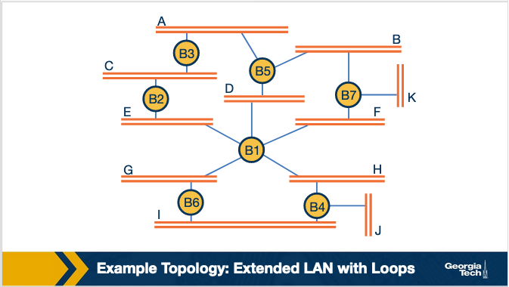
The Spanning Tree Algorithm
In the course content, “Looping Problem in Bridges and the Spanning Tree Algorithm”

Slide 4
The Spanning Tree Algorithm
Lecture’s version is a more generalized explanation
Bridges predate switches
Many resources explaining the difference online
Example: http://www.fiberopticshare.com/bridge-vs-switch-whats-the-difference.html
Older networks (and some modern networks, such as in industrial settings) used topologies like ring or bus topologies
This is why not all bridges participate in forwarding once the spanning tree is built
Project’s version involves switches
One host/switch per connection
All switches must participate in the spanning tree
Both versions are intended to prevent an infinite cycle of forwarding

Slide 5
Project Files
You will modify Switch.py, we’ll go over it in a minute.
Topology.py - Represents a network topology of Layer 2 switches. This class reads in the specified topology and arranges it into a data structure that your switch code can access.
StpSwitch.py - A superclass of the class you will edit in Switch.py. It abstracts certain implementation details to simplify your tasks.
Message.py - This class represents a simple message format you will use to communicate between switches. Create and send messages in Switch.py by declaring a message as
msg = Message(claimedRoot, distanceToRoot, originID, destinationID, pathThrough)

Slide 6
Project Files, continued
run_spanning_tree.py - A simple "main" file that loads a topology file (see XXXTopo.py below), uses that data to create a Topology object containing Switch objects, and starts the simulation.
NoLoopTopo.py, SimpleLoopTopo.py, ComplexLoopTopo.py, etc - These are topology files that you will pass as input to the run_spanning_tree.py file.
sample_output.txt - Example of a valid output file for Sample.py as described in the comments in Switch.py.
Logs/NoLoopTopo.py, Logs/SimpleLoopTopo.log, Logs/ComplexLoopTopo.log – valid output files for given topologies.

Slide 7
Switch.py – implementing the data structure
The data structure keeps track of a switch’s view of the Spanning Tree. The collection of active links from each switch’s data structure is the resultant Spanning Tree. The data structure may be any variables needed to track each switch’s own view of the tree.
Keep in mind that in a distributed algorithm, the switch can only communicate with its neighbors. A switch does not have an overall view of the tree as a whole.
The switches are trying to learn the root, which is the switch with the lowest id, and the path to that root switch. An example data structure would include, at a minimum, a variable to store the switchID that this switch currently sees as the root, a variable to store the distance to the switch’s root, and a list or other datatype that stores the “active links” (i.e., the links to neighbors that should be drawn in the spanning tree). To track the path to the root, each switch may also need to know which neighbor it goes through to get there (in the slides to follow we call this data structure variable switchThrough), and the distance of the path to the root. See examples to follow.
*TIPS: If you’re new to Python, you’ll need to understand how self works.
Do not use global variables.
Do not define your data structure in send initial message method since it will be
overwritten every time the switch class is called.

Slide 8
Switch.py – initial messages, processing messages, logging for output
Implement the Spanning Tree Protocol:
The messages are processed as a FIFO queue, but the switches do not need to push or pop on the FIFO queue since Topology.py does this for the switches as each switch calls send_msg().
As each switch processes messages, it compares the received message data to the data in its data structure to build the spanning tree.
Write a logging function that is specific to your particular data structure.
TIP: Take the time now to read all the project files, starting and ending with
Switch.py and possibly reading Message.py and Topology.py twice as well.

Slide 9
Example:
# root = id of the switch thought to be the root by the origin switch
# distance = the distance from the origin to the root node
# origin = the ID of the origin switch
# destination = the ID of the destination switch
# pathThrough = Boolean value indicating the path to the claimed root from the message’s origin passes through the message’s destination
Topology
1
2
5
3
4
6
Empty Data Structure
Switch X
root
Empty Message Queue
distance
Root Distance Origin Destination pathThrough
activeLinks
switchThrough

Slide 10
Example: Initial Data Structure and Messages sent by Switch 1
initial messages…
Topology
Message Queue
1
2
5
Root | Distance | Origin | Destination | paththrough
1 | 0 | 1 | 2 | F
1 | 0 | 1 | 3 | F
3
4
6
Data Structure
Switch 1
root
1
distance
0
activeLinks switchThrough 1

Slide 11
Example: Initial Data Structure and Messages sent by Switch 2
Topology
initial messages…
Message Queue
1
2
5
Root | Distance | Origin | Destination | paththrough
1 | 0 | 1 | 2 | F
1 | 0 | 1 | 3 | F
2 | 0 | 2 | 1 | F
2 | 0 | 2 | 4 | F
3
4
6
Data Structure
Switch 2
root
2
distance
0
activeLinks switchThrough 2

Slide 12
Example: All Initial Messages
Message Queue
Root
Distance
Origin
Destination
paththrough
Topology
1
0
1
2
F
1
0
1
3
F
1
2
5
2
0
2
1
F
2
0
2
4
F
3
4
6
3
0
3
1
F
3
0
3
4
F
4
0
4
2
F
This is the FIFO message queue at the end of sending the initial messages. Note that you may see a different order of messages.
4
0
4
3
F
4
0
4
5
F
4
0
4
6
F
5
0
5
6
F
5
0
5
4
F
6
0
6
5
F
6
0
6
4
F

Slide 13
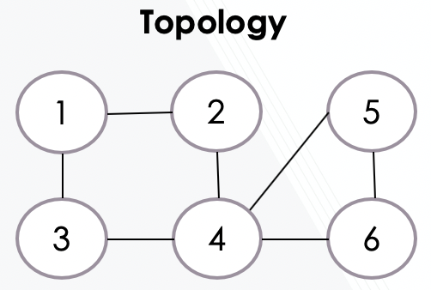
Example: Switch 2
Message Queue
Root | Distance | Origin | Destination | paththrough
1 | 0 | 1 | 2 | F
1 | 0 | 1 | 3 | F
2 | 0 | 2 | 1 | F
2 | 0 | 2 | 4 | F
3 | 0 | 3 | 1 | F
3 | 0 | 3 | 4 | F
4 | 0 | 4 | 2 | F
4 | 0 | 4 | 3 | F
4 | 0 | 4 | 5 | F
4 | 0 | 4 | 6 | F
5 | 0 | 5 | 4 | F
5 | 0 | 5 | 6 | F
6 | 0 | 6 | 4 | F
6 | 0 | 6 | 5 | F
1 | 1 | 2 | 1 | T
1 | 1 | 2 | 4 | F
Compare message.root = 1 and self.root = 2. Update self.root to be message.root, self.distance to be message.distance + 1. Add message.origin to activeLinks, and set switchThrough to message.origin. Update neighbors with new messages
Before processing
After processing
Switch 2
Switch 2
root 2
distance 0 activeLinks switchThrough 2
root 1
distance 1
activeLinks 1
switchThrough 1

Slide 14
Example: Switch 3
Compare message.root = 1 and self.root = 3. Update self.root to be message.root, self.distance to be message.distance + 1. Add message.origin to activeLinks, and set switchThrough to message.origin. Update neighbors with new messages
Before processing
After processing
Switch 3
Switch 3
Message Queue
root 3
distance 0 activeLinks switchThrough 3
root 1
distance 1
activeLinks 1
switchThrough 1
root | distance | Origin | Destination | paththrough
1 | 0 | 1 | 3 | F
1 | 1 | 3 | 1 | T
1 | 1 | 3 | 4 | F

Slide 15
Example: Switch 6
Compare message.root = 1 and self.root = 1
No update to self.root
Compare message.distance+1 = 3 and self.distance = 4
Update self.distance, self.activeLinks, self.switchThrough
Update neighbors
After many messages are sent and processed …
Data Structure
Message Queue
Before processing
After processing
root | distance | Origin | Destination | paththrough
1 | 2 | 4 | 6 | F
1 | 3 | 6 | 4 | T
1 | 3 | 6 | 5 | F
Switch 6
Switch 6
root 1
distance 4 activeLinks 5 switchThrough 5
root 1
distance 3
activeLinks 4
switchThrough 4

Slide 16
Example: Switch 4
Compare message.root = 1 and self.root = 1
No update to self.root
Compare message.distance+1 = 4 and self.distance = 2
No update to self.distance
pathThrough = True, update self.activeLinks
Data Structure
Message Queue
Before processing
After processing
root | distance | Origin | Destination | paththrough
1 | 3 | 6 | 4 | T
Switch 4
Switch 4
root 1
distance 2 activeLinks 3 switchThrough 3
root 1
distance 2
activeLinks 3, 6
switchThrough 3

Slide 17
Example: Switch 4
Compare message.root = 1 and self.root = 1
No update to self.root
Compare message.distance+1 = 2 and self.distance = 2
No update to self.distance
message.origin < self.switchThrough
Update self.activeLinks, switchThrough
Notify neighbors
Message Queue
Data Structure
root | distance | Origin | Destination | paththrough
1 | 1 | 2 | 4 | F
1 | 2 | 4 | 2 | T
1 | 2 | 4 | 3 | F
1 | 2 | 4 | 5 | F
1 | 2 | 4 | 6 | F
Before processing
After processing
Switch 4
Switch 4
root 1
distance 2 activeLinks 3, 6 switchThrough 3
root 1
distance 2
activeLinks 2, 6
switchThrough 2

Slide 18
Example: Final Spanning Tree
LOG FILE
1 - 2, 1 - 3
2 - 1, 2 - 4
3 - 1
4 - 2, 4 - 5, 4 - 6
5 - 4
6 - 4
Final Data Structures
switchID | root | distance | activeLinks | switchThrough
1 | 1 | 0 | 2,3 | 1
2 | 1 | 1 | 1,4 | 1
3 | 1 | 1 | 1 | 1
4 | 1 | 2 | 2,5,6 | 2
5 | 1 | 3 | 4 | 4
6 | 1 | 3 | 4 | 4

Slide 19
Key Assumptions for the Project
You should assume that all switch IDs are positive integers, and distinct.
These integers do not have to be consecutive and they will not always start at 1.
Tie breakers: All ties will be broken by lowest switch ID, meaning that if a switch has multiple paths to the root of the same length, it will select the path through the lowest id neighbor. For example, assume switch 5 has two paths to the root, through switch 3 and switch 2. Assume further each path is 2 hops in length, then switch 5 will select switch 2 as the path to the root.
Combining points one and two above, there is a single distinct solution spanning tree for each topology.

Slide 20
Key Assumptions for the Project
You can assume all switches in the network will be connected to at least one other switch, and all switches are able to reach every other switch.
You can assume that there will be no redundant links and there will be only 1 link between each pair of connected switches.
You can assume that the topology given at the start will be the final topology and there won’t be any changes as your algorithm runs (i.e adding a new switch).
Note that when a switch deactivates/blocks a port, this port is not completely discarded. While the switch treats it as inactive, it will still be communicated with during the simulation.

Slide 21
class StpSwitch(object):
def __init__(self, idNum, topolink, neighbors):
# switchID = id of the switch (lowest value determines root switch and breaks ties.)
# topology = backlink to the Topology class. Used for sending messages.
# as follows: self.topology.send_message(message)
# links = a list of the switch IDs linked to this switch.
self.switchID = idNum <_ OK TO USE!
self.topology = topolink. <- DO NOT USE !!!
self.links = neighbors. <- OK TO USE!
# Invoked at initialization of topology of switches, this does NOT need to be invoked by student code.
def verify_neighbors(self):
''' Verify that all your neighbors has a backlink to you. '''
for neighbor in self.links:
if self.switchID not in self.topology.switches[neighbor].links:
raise Exception(str(neighbor) + " does not have link to " + str(self.switchID))
# Wrapper for message passing to prevent students from having to access self.topology directly.
def send_message(self, message):
self.topology.send_message(message)

Slide 22
CONCLUSION
Read the project description, linked materials, Piazza posts and provided code
Attend TA chats as needed (there are a few every week that Project 2 is open)
Take time to implement your solution
A good approach can be to tackle the problem in stages, and along the way either use print statements or a debugging tool to see the messages passed between switches, and to see values of switch member variables as they update when the switches together build the spanning tree for a topology by sharing information through message passing.
Incrementally add perhaps small pieces of your code at the Switch.py TODO placemarks, and observe how your code behaves. Gradually implement the Switch data structure, initial message passing, logic to process messages and code to write the logfile output according to the assignment requirements.
Sample.py is a good place to start testing your code because it is so simple. NoLoopTopo.py adds additional complexity that might challenge your initial code, and you will find even more demands on your solution from TailTopo.py and ComplexLoopTopo.py. The more topologies you can test your solution on, the more confidence you can have that your code addresses all the corner cases.
Good Luck!

